Slide 1


SEMESTER PROJECT
SEMESTER 4
MAY 14, 2021
4ECE2-A

Slide 2




EMOTIONAL FACE RECOGNITION SYSTEM
USING PYTHON
Team Description
ANMOL GUPTA
SUSHANT KUMAR
MENTOR
LEADER
19BEC1102
PROBLEM
IDENTIFICATION | FRAMEWORK
19BEC1078
VALIDATED
SOLUTION
DR. YOGENDRA NARYAN
ASSISTANT PROFESSOR
ELECTRONICS AND COMMUNICATION ENGINEERING
UIE, CU
DEVESH SEHGAL
PARAS KUMAR
19BEC1099
TROUBLESHOOTER
19BEC1082
MAKING IDEA & DESIGNS

Slide 3








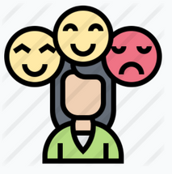
Methodology
EMOTIONAL RECOGNITION SYSTEM
USING PYTHON

Slide 4


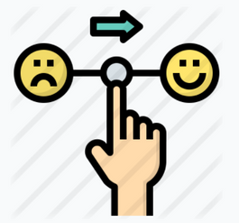

EMOTIONAL RECOGNITION SYSTEM
using PYTHON
It’s now easier than before to verify the identity of a person's emotions. Emotional Face recognition can be applied in many fields, one being smart devices and eco-friendly applications that will change the mood of a person easily.
ACCESSIBILITY
USER-FRIENDLY
MOOD CONTROL
ZERO COST

Slide 5







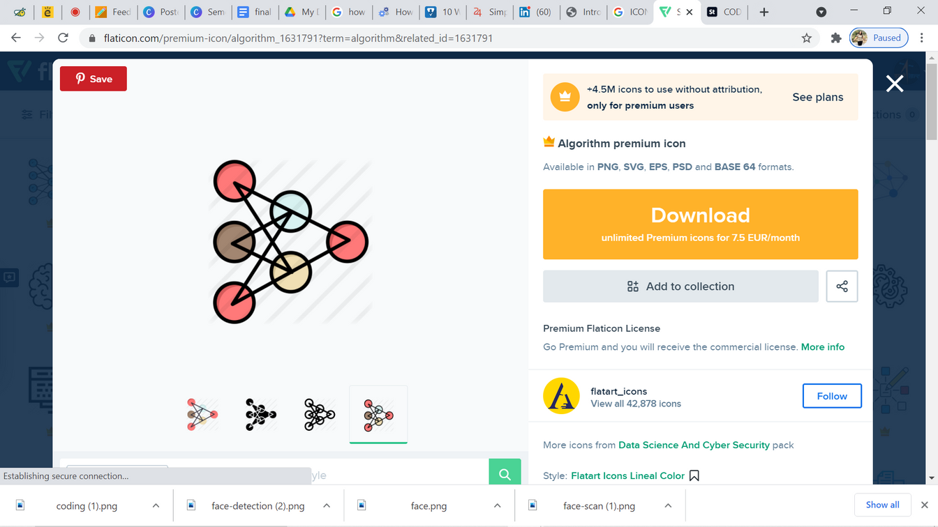



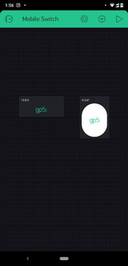
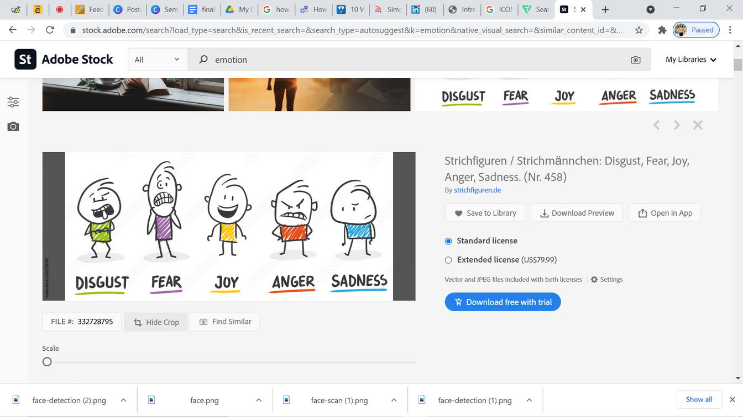
Prototype Sketch
CODING & FRAMEWORK
SERVER
LIVE CAMERA
FACE DETEACTION
OUTPUT
EXECUTION ALGORITHM
LOCAL WI-FI
PERSONAL
MOBILE

Slide 6


FRAMEWORK
ANACODA
Anaconda is a distribution of the Python and R programming languages for scientific computing (data science, machine learning applications, large-scale data processing, predictive analytics, etc.
PYTHON LIBRARIES
A Python library is a reusable chunk of code that you may want to include in your programs/ projects. Compared to languages like C++ or C, Python libraries do not pertain to any specific context in Python. Here, a 'library' loosely describes a collection of core modules.

Slide 7
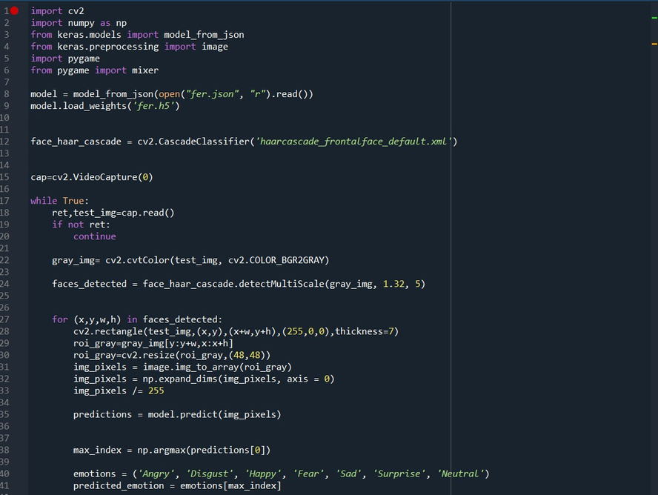
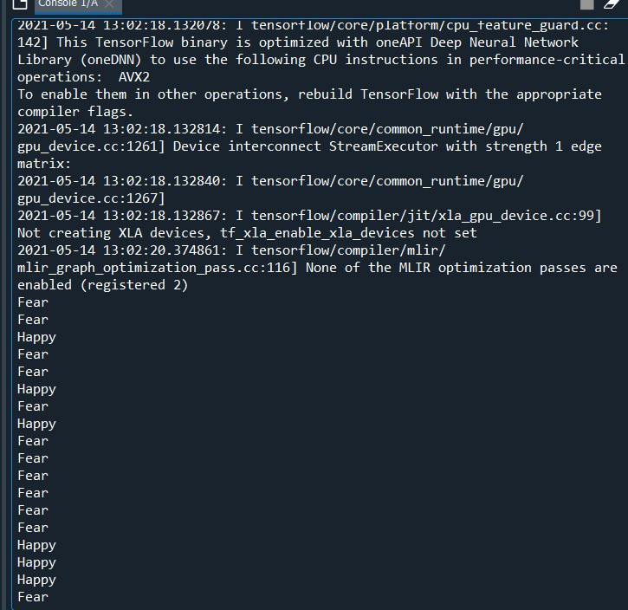
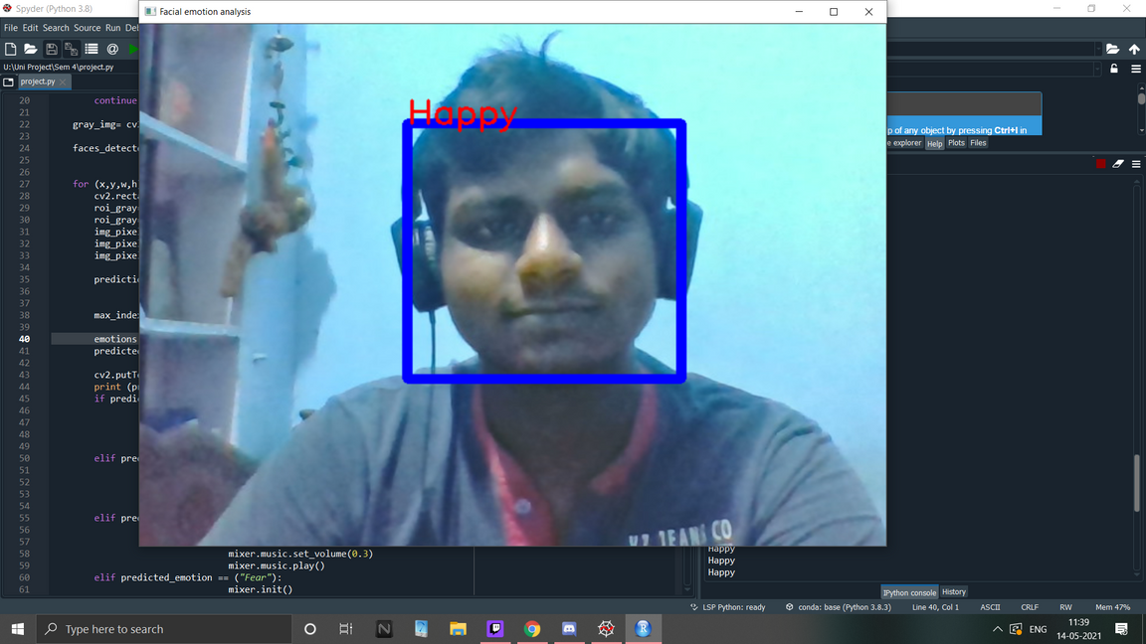
PROGRESSIVE PICTURES OF PROJECT

Slide 8

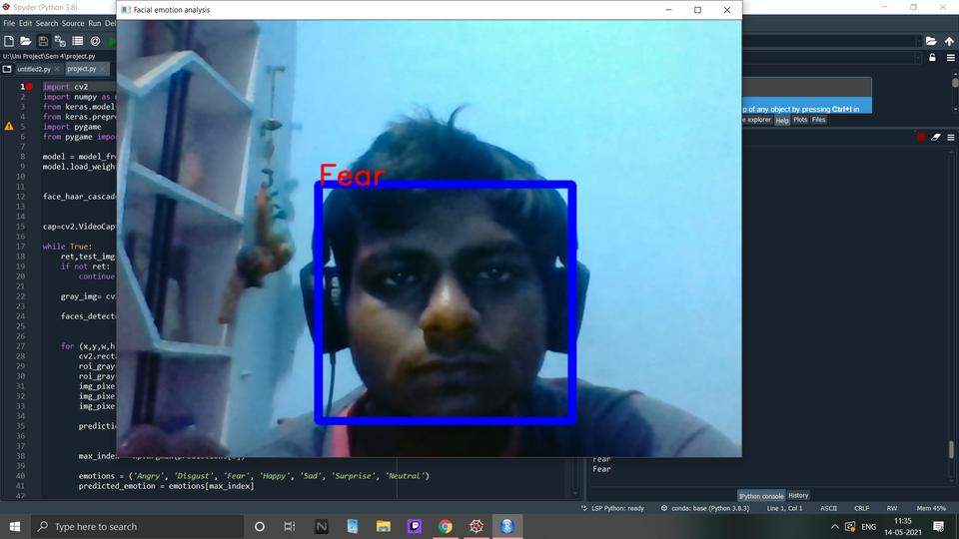
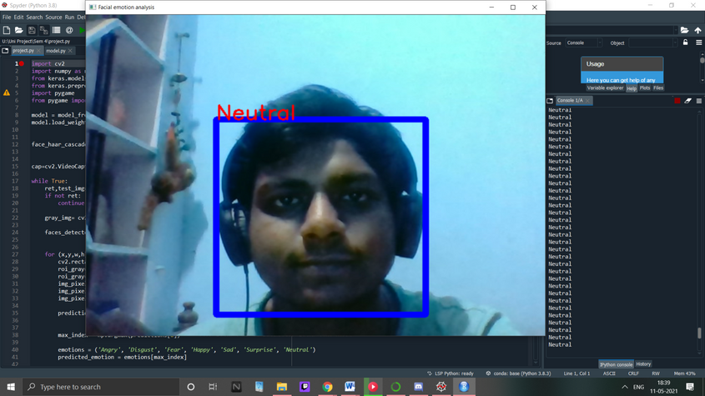
EMOTIONAL RECOGNITION SYSTEM
using PYTHON
19BEC1102
19BEC1078
19BEC1082
19BEC1099
FEAR
NEUTRAL
"It's a software that helps in recognizing emotions and then based on the emotions does certain tasks as intended"
SUSHANT KUMAR
HAPPY

Slide 9
THANK YOU !

